Slide 1

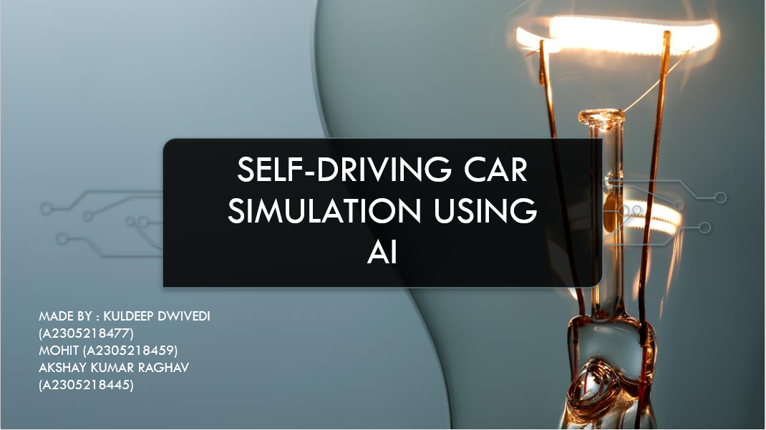
FACULTY GUIDE : Mrs. SEEMA SHARMA

Slide 2
ABSTRACT
"The technology is ahead of the level of governance in many areas," according to the report, which states that "all presume to have a human running the vehicle." "The technology is currently advancing so quickly that it is in danger of outstripping existing standards," according to the report. Such huge concerns have put the research on hold for a long time. With encouraging trials and continued improvement, the driverless automobile, also known as an autonomous car, has become a hotbed of study and expertise.
The goal of this project is to create and optimize a software implementation required for the detection of location i.e. localization, dynamic path finding from a fixed source to fixed destination in a real time scenario and also the necessary controller for the efficient control of an autonomous or the self driving car.
To achieve this goal we will be using several artificial intelligence technique for localization such as Kalman Filters, Histogram Filters and the heuristic approach algorithm A* for dynamic path finding.

Slide 3
INTRODUCTION
AI research is highly technical and specialized, and is deeply divided into subfields that often fail to communicate with each other. Some of the division is due to social and cultural factors: subfields have grown up around particular institutions and the work of individual researchers. AI research is also divided by several technical issues. Some subfields focus on the solution of specific problems. Others focus on one of several possible approaches or on the use of a particular tool or towards the accomplishment of particular applications.
In this project, we will implement a program for Google’s self-driving car by using several artificial intelligence techniques for localization such as Kalman Filters, Histogram Filters and the heuristic approach algorithm A* for dynamic path finding.
The dynamic path finding is very useful as it will give instant path directions based on the current car location. The A* algorithm, which is used to implement path based on the current and final location is very fast in comparison with Dijkstra and BFS. Later we implement PID controller to find the smoothest path to the destination as A* gives only square paths.

Slide 4
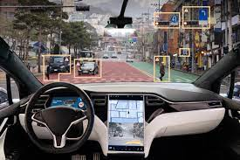
AI TECHNIQUES
LOCALIZATION
PARTICLE FILTER
KALMAN FILTER
MOTION PLANNING
PID CONTROLLER

Slide 5
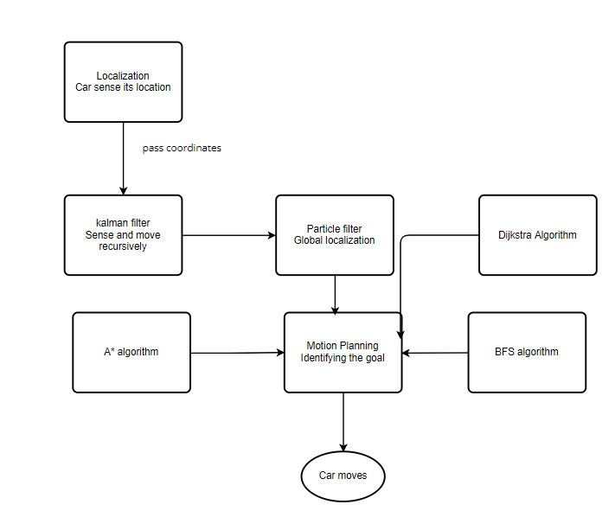
FLOW CHART

Slide 6
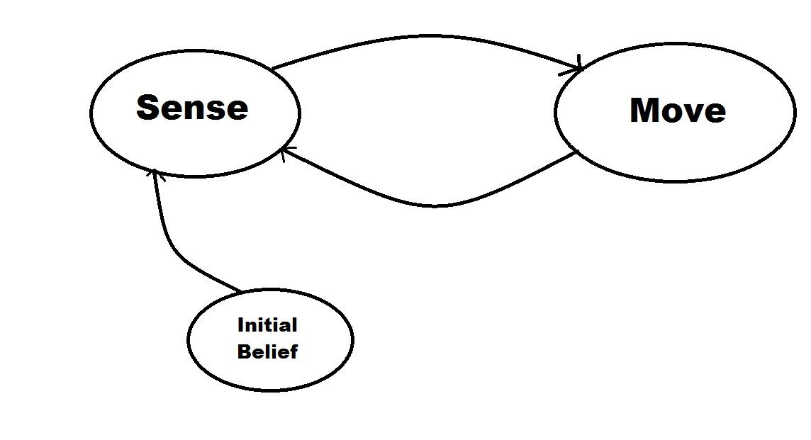
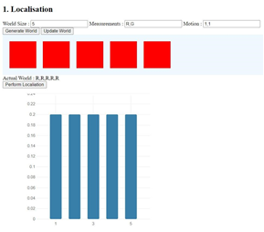
LOCALIZATION
In order to drive the car must first we have to locate it. However it is not quite possible to measure a car location using an instrument. Even the GPS have margin of error of around 5 m. Now, think about this error on a standard driving lane whose width is 3.5 m. So, to solve this problem a method called Localization is used.

Slide 7
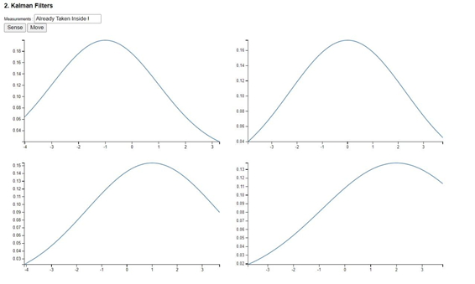
KALMAN FILTER
However, though a robot represents localizing itself and perceiving others with very similar underlying models, the two problems are solved using different algorithms. Instead of using a particle filter to estimate position, perceiving other objects is solved with kalman filters. Kalman filters make an additional assumption about the variables that they are tracking. The algorithm assumes that the location variables are gaussian. This assumption simplifies the problem into one where the solution to where the other cars are can be computed exactly (and thus much faster).

Slide 8
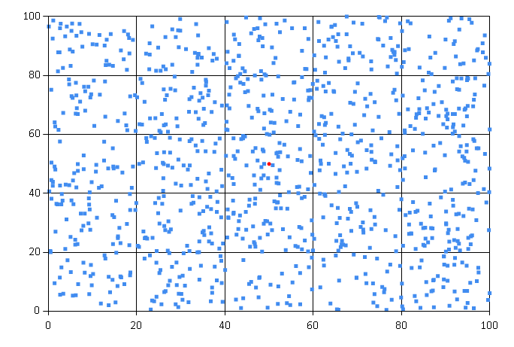
PARTICLE FILTER
Particle filters are attractive to robot cists for more than one reason. First and foremost, they can be applied to almost any probabilistic robot model that can be formulated as a Markov chain. Furthermore, particle filters are anytime such that they do not require a fixed computation time; instead, their accuracy increases with the available computational resources. This makes them attractive to roboticists, who often face hard real-time constraints that have to be met using hard-to-control computer hardware.

Slide 9
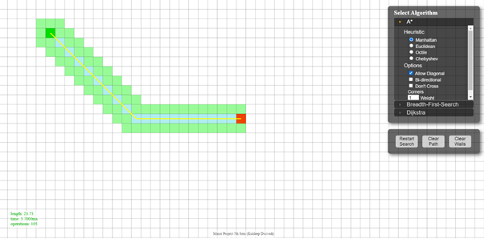
MOTION PLANNING
The fundamental problem in motion planning is that a robot might live in a world that looks like the one pictured below and will want to find a goal like $. The robot has to have a plan to get to its goal, as indicated by the red line route.
This same problem occurs for a self-driving car that lives in a city and has to find its way to its target location by navigating through a network of streets and along the highway.
Given: 1. Map Starting Location
2. Goal Location Cost (time it takes to drive a certain route)
3. Goal: Find the minimum cost path.

Slide 10
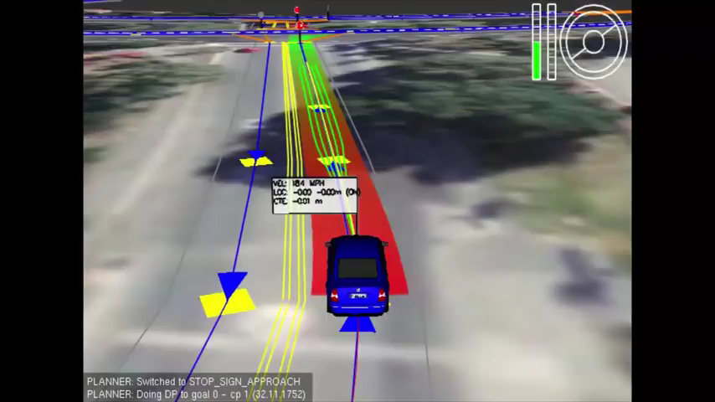
VISUALIZATION

Slide 11
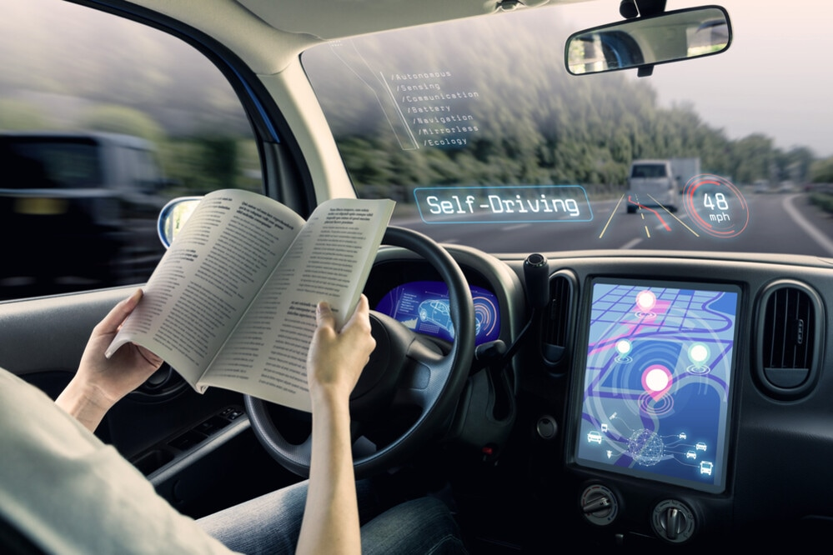
CONCLUSION
The software implemented will be a key part in designing the self-driving car. The techniques used for particle tracking , motion planning and smoothing minimizes error rates to maximum extent and helps in designing a reliable Working self – driving car . Except for the software implementation, a lot goes into implementing the actual car itself .
Efforts can be made to further optimize the error rates in future so that such cars can be used in future in general traffic.

Slide 12
REFERENCES
[1] https://www.udacity.com/course/artificial-intelligence-for-robotics--cs373
[2]http://en.wikipedia.org/wiki/Autonomous_car
[3]http://robohub.org/how-do-self-driving-cars-work/
[4]http://biorobotics.ri.cmu.edu/papers/sbp_papers/integrated3/kleeman_kalman_basics.pdf
[5]http://robots.stanford.edu/papers/thrun.pf-in-robotics-uai02.pdf
[6]http://theory.stanford.edu/~amitp/GameProgramming/AStarComparison.html
[7]http://en.wikipedia.org/wiki/PID_controller

Slide 13
THANK YOU!!!

